Slide 1
Welcome to the expectation meeting for Woodpeckers Class
The teacher in Woodpeckers is Mr Rammell
Other members of staff that will be working in the class include Mrs Edwards, Mrs Gilpin, Mrs Whittingham and Mrs Barber

Slide 2
Springfields Behaviour Policy
The pupils at Springfields First School are taught how to behave by following the school rules:
Be Ready, Show Respect & Stay Safe.
Pupils are expected to:
be ready to learn
to be respectful and tolerant towards others
to stay safe at all times
We want to see that the children are-
displaying good manners
arriving to school dressed appropriately and with any equipment that they need

Slide 3
Rewards and sanctions We have high expectations of behaviour at Springfields First School. The behaviour of the children is excellent.
When a pupil’s behaviour meets or goes above and beyond the expected behaviour standard, staff will recognise it with positive recognition and reward. Positive behaviour will be rewarded with:
Verbal praise and/or a class round of applause
A cheer and/or sticker
Having their name added to the ‘Recognition Board’
Team points
Praise cards are sent home
Certificates during celebration assembly
Positions of responsibility (trusted with a specific job)
Whole-class rewards may include time to do a popular activity etc.

Slide 4
Rewards and sanctions We have high expectations of behaviour at Springfields First School. The behaviour of the children is excellent.
The school may use one or more of the following sanctions in response to unacceptable behaviour:
A reminder of the behaviour expected in school
Sending the pupil out of the class for a short period of time, to regain self -control or reflect on their actions
Expecting work to be completed at home, or at break or lunchtime
Loss of privileges – for instance, the loss of a prized responsibility
Referring the pupil to a senior member of staff
Phone call home to parents
Agreeing a behaviour plan, with pupil and parents
Children are always given space to process their actions and have time to talk about what and why they have gone wrong. We talk about making the right/ wrong choices and that all our actions have consequences with positive or negative outcomes.

Slide 5
MON | Spelling | Maths | Break | English | Lunch/ play time | Science History/Geography | Assembly 2.45pm |  | Class read Home time
TUES | Spelling | Maths | Break | English | Lunch/ play time | Computing RE | Singing 2.45pm |  | Class read Home time
WED Mrs Whittingham = PPA in Woodpeckers am session | Handwriting | Maths | Break | English | Lunch/ play time | Art/ D&T Online Safety | Assembly 2.45pm |  | Class read Home time
THURS | Spelling | Maths | Break | English | Lunch/ play time | Swap around afternoon: PE/French/PSHE |  |  | Class read Home time
FRI- Fitness Friday | 9.00am Celebration assembly | 9.30-10.00= English (half a lesson) 10.00-10.30= Woodpeckers dance | Break | Maths 10.40-11.30am | Lunch/ play time | English (second half) Music Golden Time |  | Class read Home time

Slide 6
Curriculum At Springfields First School, we believe that learning should be fun, purposeful and challenging. Through our creative curriculum we aim to equip each child with the skills that they need for lifelong learning.
 | Autumn | Spring |  | Summer
Cycle 2 2024-2025 | The Romans |  | Going Green
Cycle 1 2025-2026 | Time Travellers |  | Chocolate

Slide 7
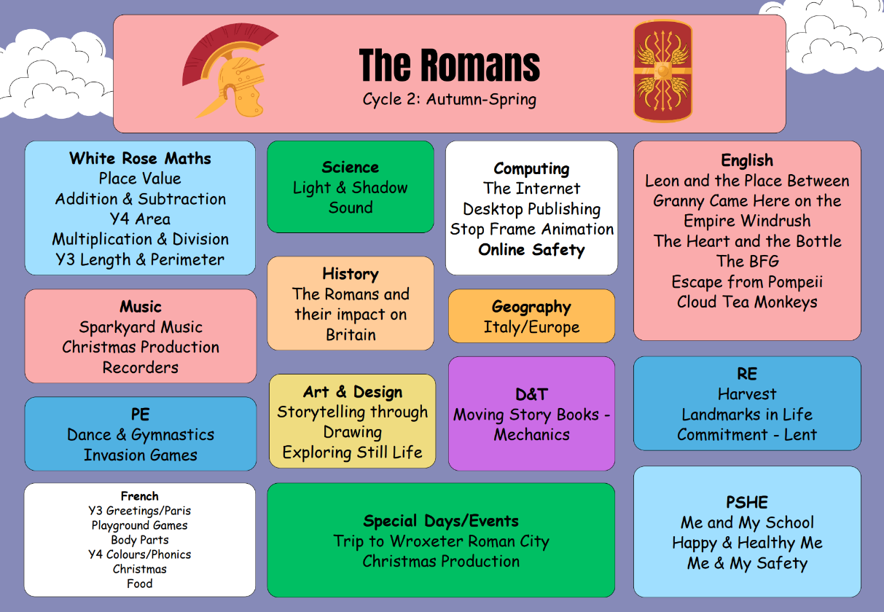
Topic Web

Slide 8
Homework We try to make homework relevant to the children and endeavour to give them a variety of activities that may challenge them with new learning or may practise skills already learnt in class.
A little and often is the most effective way to learn
Times tables, Spellings and Maths facts,
and let’s not forget…to develop reading skills.
English
Reading- The children will have a set day for changing their reading books each week.
Children should be reading at least 3 times at home during the week. As independent reading develops, make sure you talk to your child about what has been read to check comprehension. All reading counts…magazines, library books, bedtime stories, school reading books. Please write in the diary ready for your child’s reading day. It is important to show that your child has read at home with you.
Spelling- The children will complete weekly homework tasks on Spelling Shed.
Maths
Times Tables zones sheets will start to come home for practising. A TT rockstars log-in will be in your child’s diary once we have practised how to use it in class.
This fluency is vital to children being able to master Maths and it under-pins all areas.
Maths and English homework will be issued on Friday. Your child will be given a homework book to complete tasks and will need to return it for Thursday each week.
In KS2, if your child persistently avoids doing homework, they will have to do it during free-choice ‘golden time’ on Fridays.

Slide 9
Additional information
PE days are Thursday and Friday please ensure that children bring the appropriate school PE kit on Thursday and wear Fitness Friday clothes on Friday. (No non-uniform sportswear please).
For those taking part in after school sports clubs, please bring kit in a bag to change into rather than wearing the PE kit all day.
Please provide a red hoodie, white top and black shorts/tracksuit bottoms for your child to wear. Some lessons will take place indoors and some outdoors. Hair should be tied back, and no jewellery should be worn.
Please ensure that if home-time arrangements are different to normal that you let school know in writing or by phone.
Please encourage your child to take more responsibility for their school equipment in KS2 – PE kits, homework, looking after school uniform etc. This independence will really benefit your child when they go to middle school.
Woodpeckers class assembly- .Thursday 17th October

Slide 10
Thank you for attending this meeting.
Contacting us-
Please speak to us at the door or write a note in your child’s diary.
. If that is not possible, feel free to contact the school on office@springfields-first.staffs.sch.uk. Please allow time for us to receive your email from the office and respond. We’ll endeavour to reply as soon as it is possible outside of teaching time before 5.00p.m.

