Slide 1
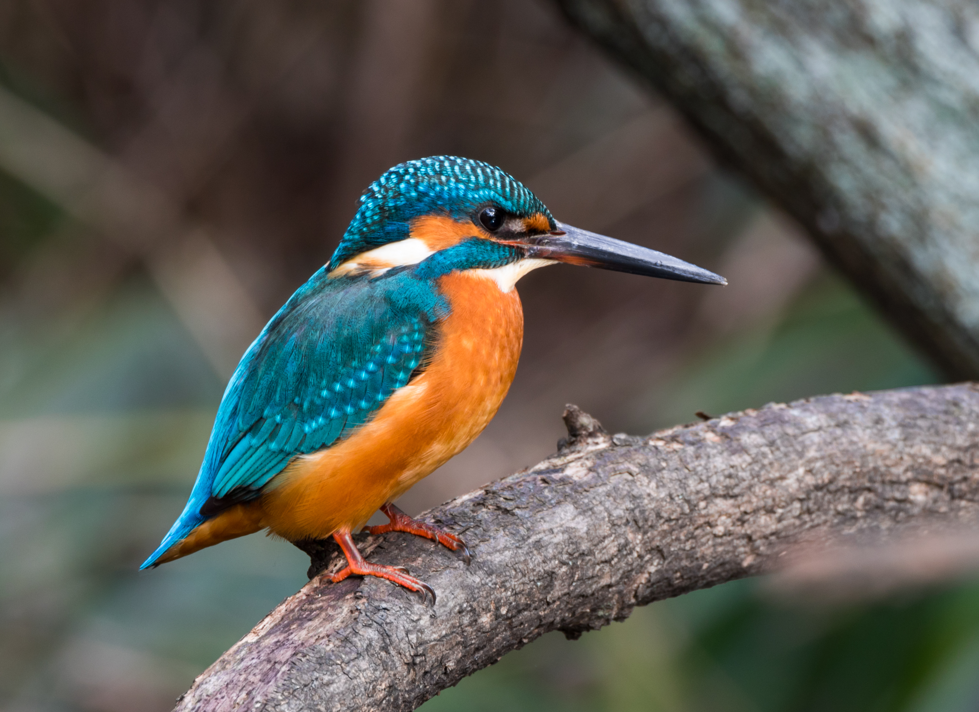
Welcome to the expectation meeting for kingfishers Class
The teachers in Badgers Class are Mrs. Brett and Mrs Scott
Teaching assistants providing support/ interventions: Mrs Gilpin, Mrs Edwards, Mrs McKnight, Mrs Whittingham & Mrs Barber

Slide 2
We expect the children at Springfields First School -
To be respectful and tolerant towards each other
To respect all the adults within school
To behave sensibly
To follow the school rules- Be ready, Stay safe, Show respect
To display good manners
To come to school dressed appropriately and with any equipment they may need.

Slide 3
Rewards and sanctions We have high expectations of behaviour at Springfields First School. The behaviour of the children is excellent.
At Springfields, we reward good behaviour, hard work, effort and attainment with stickers, team points and certificates.
We work on a ‘3 chance’ system- remind, warn, last chance- time out consequence.
Children are always given space to process their actions and have time to talk about what and why they have gone wrong. We talk about making the right/ wrong choices and that all our actions have consequences with positive or negative outcomes.
Recognition Board- instilling sense of team spirit and striving towards a shared goal. Aim is to get everyone on the recognition board so that the class team can celebrate with cheers, claps and stickers etc.
Raffle tickets, team points, smiley faces, pink ticks, stickers, certificates etc….

Slide 5
Curriculum At Springfields First School, we believe that learning should be fun, purposeful and challenging. Through our creative curriculum we aim to equip each child with the skills that they need for lifelong learning.
Curriculum Overview – Long Term Plan
Year Two 2016-2017
2024-2025 | Autumn | Spring | Summer
 | The Romans- History focus Part 1 | The Romans- Geography focus Part 2 Going Green Part 1 | Going Green Part 2

Slide 6
Weekly Homework
A little and often is the most effective way to learn
Times tables, Spellings and Maths facts,
and let’s not forget…to develop reading skills.
Reading Monday – Friday- Change reading practice & library books
English
Children should be reading at least 3 times during the week. As independent reading develops, make sure you talk to your child about what has been read to check comprehension. All reading counts…magazines, library books, bedtime stories, school reading books. Please write in the diary ready for your child’s reading day. It is important to show that your child has read at home with you so new books can be chosen.
Spelling Shed: Log-ins will come home this week. A guide for parents will be emailed to you to show you how the website works. Homework assignments will be set each Friday and scheduled to finish by 5p.m, the following Thursday. Please make sure your child practises at least 3 times during the week. The homework will link to the spelling lessons each week.
Maths
Homework will be based upon learning known facts and developing fluency in these. Times Tables zones will be sent home to practise. Also, a TT rockstars log-in will be in your child’s diary. Year 4 children are already familiar with it, but it is new to Year 3 children.
Maths and English homework will be issued on Fridays. Your child will be given a homework book to complete tasks and will need to return it on Thursdays to use in school. We ask that any online homework is completed by 5.00pm Thursday.
In KS2, if your child avoids doing homework regularly, they will have to do it during free-choice ‘golden time’ on Fridays. If you have any technical issues or other difficulties, please talk to us so that we can help.

Slide 7
Additional information
PE days are Thursday and Friday
Please ensure that your child comes dressed in their school PE kit. (No non-uniform sportswear please). Please provide a red hoody and black tracksuit bottoms/ shorts or leggings for your child to wear. Hair, below shoulder length, should be tied back. Jewellery (excluding those worn for religious purpose)should not be worn and earrings should be removed or covered with tape (e.g. micropore). This should be supplied from home. Teachers are not permitted to remove earrings or put them back in. Sorry!
If your child is attending an after-school sport club, please bring kit to change into.
Please ensure that if home-time arrangements are different to normal that you let school know in writing, by phone or tell us at the door.
Drinking water- please send your child to school with a named full bottle of water. Bottles can be re-filled but we don’t have instant access to drinking water in our KS2 rooms. Please avoid sending in glass bottles.
Snacks- please send in healthy snacks for break times (no sweets, chocolate, crisps or food containing nuts).
Please make sure hoodies, jumpers, cardigans, coats, and hats have your child’s name written in. It is difficult to locate and return lost uniform that is unnamed. It is good practice for KS2 children to become more responsible for their belongings, particularly for Year 4 children in preparation for moving on to Middle School.

Slide 8
Thank you for attending this meeting.
Contacting us:
Speak in person on the door or write a note in your child’s diary
office@springfields-first.staffs.sch.uk- please allow time for us to receive your email from the office and respond. We’ll endeavour to reply as soon as it is possible outside of teaching time before 5.00p.m.

