Slide 1
Springfields First School
Year 4 Multiplication Tables
Check Presentation
2024

Slide 2
What is the purpose of the multiplication tables check?
To determine whether year 4 pupils can fluently recall their multiplication tables.
To help schools to identify pupils who require additional support.
Children will only be considered fluent in their times tables if they
achieve full marks.
The DfE will create a report on overall results across all schools in England to measure improvements.
Notes:
The check is not intended as a diagnostic tool.
Unlike the KS1 Phonics Screening check, children will not be expected to re-sit the check if they do not meet a set threshold.

Slide 3
When the multiplication tables check will be carried out
There will be 3-week window in June for the administration of the check.
There is no set day to administer the check.
Children are not expected to take the check at the same time.
All eligible* year 4 pupils England will be required to take the check.
*If a pupil is not entered for the check, the school should inform the pupil’s parents.
Notes:
It is up to individual schools to decide how the check is administered – some schools will administer individually while others will take small groups out or administer to the whole class.

Slide 4
How the multiplication tables check is carried out
The check will be fully digital and take place on screen.
Children will be able to use Chrome Books.
Answers will be entered using a keyboard.

Slide 5
How the multiplication tables check is carried out
Under standard administration* the multiplication check will take less than 5 minutes per pupil.
Children will get 6 seconds from the time the question appears to input their answer.
There will be 25 questions with a 3 second pause in-between questions.
*Some pupils will be eligible for specific arrangements.
Notes:
6 seconds per answer means that children must be able to read, recall and enter their response within that time. Whatever is written in the answer box at the end of 6 seconds will be counted as the answer i.e. if the student intends to write 144 and only 14 is typed when the timer ends, their recorded answer is 14.

Slide 6
Specific arrangements for multiplication tables check
Children with additional needs, who have similar provision in their day-to-day learning at school, may be allotted specific arrangements, including:
Colour contrast;
Font size adjustment;
‘Next’ button (alternative to 3-second pause);
Removing on-screen number pad;
An adult to input answers;
Question reader;
Audible time alert.

Slide 7
The questions
Each pupil will be randomly assigned a set of questions.
There will be repeated questions across different checks each year, but no more than 30% of questions will be repeated in any two checks.
Children will only face multiplication statements in the check (not related division facts).
Pupils will not see their individual results when they complete the check.
Notes:
Repeated questions – 30% repetition rate means that if the check gets interrupted and children need to re-start it, they will only have a minimal advantage.
The results will be sent to the schools when all the checks have been completed but it is then up to the school if they report the results or not.

Slide 8
During the check
There will always be questions from the 3, 4, 5, 6, 7, 8, 9, 11 and 12 multiplication tables in each check.
There will be no questions from the 1 times table (i.e 1 x 8 or 8 x 1).
The 6, 7, 8, 9 and 12 times tables are more likely to be asked.
There will only be a maximum of 7 questions from the 2, 5 and 10 times tables.
Reversal of questions will not feature in the same check e.g. 2 x 7 and 7 x 2.
Notes:
The STA state that there is a focus on the 6, 7, 8, 9 and 12 times tables as they are the ‘most difficult’ multiplication tables.
Reversal questions = 8 x 6 and 6 x 8

Slide 9
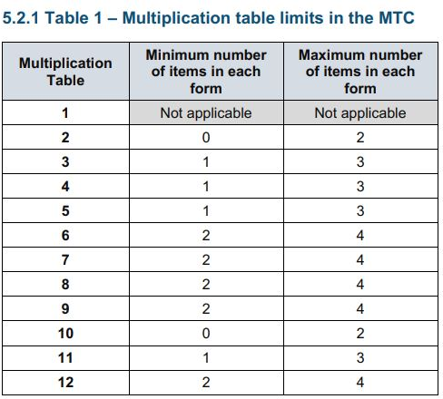
Multiplication table limits
The STA state that they are classifying the multiplication tables by the first number in the question. For example, 8 x 3 would fall within the 8 times table.

Slide 10
Questions more likely to appear
The following 11 multiplication questions are more likely to be asked:
  6 x 6 6 x 7 6 x 8 6 x 9 6 x 12
  7 x 8 7 x 9 7 x 12
  8 x 9 8 x 12
  12 x 12
Notes:
The framework sets out that the second number in the multiplication will be monitored to ensure that the instances of each number is +/- 1 of the parameters discussed before. From that, the 11 questions at the top of the slide are more likely to be asked (with their commutative equivalents).
Not each set of questions will feature all of these facts, and other questions will be asked, but it is likely that a good proportion of the above will be present in each set of questions.

Slide 11
Before the check
Children can practise before taking the check
There will be a ‘try it out’ area the children can use to become familiar with the timings and layout of the check.

Slide 12
How the school teaches times tables so pupils learn instant recall
Teaching times tables facts first:
Counting and looking for patterns
Repeated addition
Multiplication is commutative
Multiplication is the inverse of division
Number or fact families
Use of different representations:
Concrete manipulatives such as counters or cubes
Pictorial representations such as arrays

Slide 13

Counting and looking for patterns
Counting in 2s
2, 4, 6, 8, 10…
Ensure children have a strong understanding of counting in groups first.
When children are secure with counting, they can then look for patterns.
Notes:
Counting will start before beginning to develop understanding and reasoning but will continue long after, until all times tables can be counted through sequentially at speed.
Counting using manipulatives should start with physical objects (shoes, socks, hands etc) before moving on to counters etc
Whenever starting children counting in a new amount, such as counting in 8s, children should be given the opportunity to see visually what that looks like to reinforce 4 x 8 looks quite big compared to 4 x 6.
Patterns could be 4 x 8 is the same as 4 x 4, doubled.

Slide 14
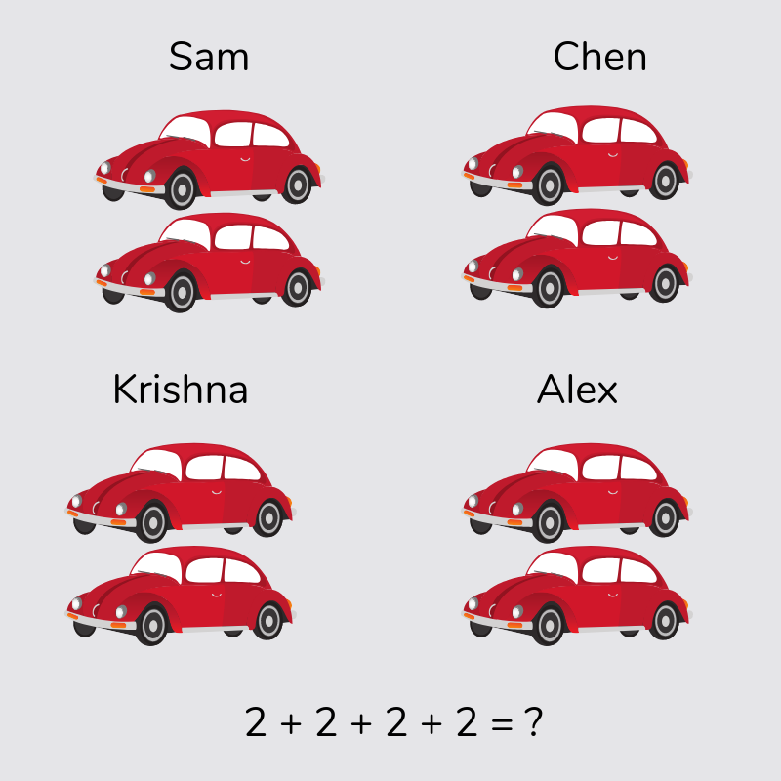
Repeated addition
Knowing that 2 x 4 is the same as 2 + 2 + 2 + 2
Notes:
Children need experience of using concrete manipulatives such as counters or multilink cubes and pictorial representations of objects, forming arrays.

Slide 15
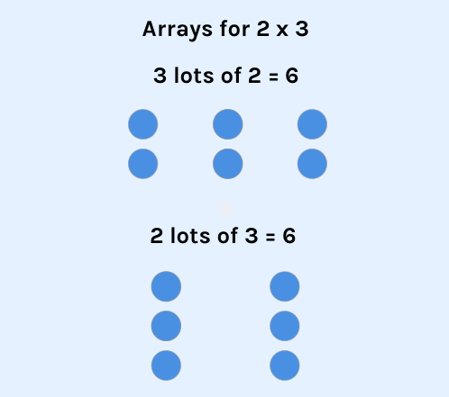
Multiplication is commutative
3 x 2 is the same as 2 x 3.
Children need to understand that multiplication can be completed in any order to produce the same answer. Sometimes this link needs to be made explicit.
Notes:
Children build on their existing understanding using arrays, turning the arrays around to show that you now have 2 groups of 3 and they will still total 6. This can then be linked to recalling multiplication facts, i.e. if they know their 2 times table as facts but not their 3 times table, they can use 2 x 3 to work out 3 x 2.

Slide 16
Multiplication is the inverse of division
20 ÷ 5 = 4 can be worked out because 5 x 4 = 20.
Using pictorial representations (such as arrays) is useful here for children to see the link between multiplication and division.
Notes:
Again, the use of arrays is key. Children need experience of pulling arrays apart into groups or sharing. After basic experience has been gained, the children should start to ‘see’ an array structure as 5 groups of 4 equal 20 and 20 can be split into 5 groups of 4.

Slide 17
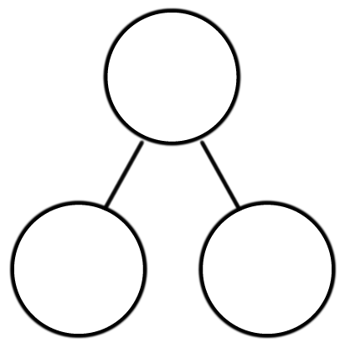
Number or fact families
4 x 5 = 20
5 x 4 = 20
20 ÷ 5 = 4
20 ÷ 4 = 5
Due to their commutative understanding, children should also be able to see whole number families. For many children this will need to be pointed out and discussed.
20
4
5
Notes:
From here it is only a short jump to understanding that any missing number can be worked out through knowledge of number families, e.g. 4 x [ ] = 20 or [ ] ÷ 4 = 5. There are other methods children can use to work out missing numbers but our goal is to increase working memory in order to increase instant recall from long term memory. Being able to bounce around a number family will achieve that.

Slide 18
Using known facts
7 x 12 = ?
I know 7 x 11 = 77
Therefore, 77 + 7 = 84
By using known facts from ‘easier’ times tables, children should be able to find answers with increasing speed.

Slide 19
Example multiplication table check
You can use this free multiplication table check which will give you an idea of the speed at which children will be asked questions:
https://mathsframe.co.uk/en/resources/resource/477/Multiplication-Tables-Check
https://www.timestables.co.uk/multiplication-tables-check/

Slide 20
How can I support my child in preparing for their multiplication tables check?
Firstly, a positive attitude goes a long way – so as much encouragement and support as possible (but we don’t need to tell you that)!
Some further tips:
Make times tables fun;
  Climb stairs counting in multiples
  Play verbal times tables games
  Listen to and learn times tables songs (Hopscotch on YouTube)
  Take it in turns to say different times tables in funny voices (i.e. say 2 x 3 = 6 in a lion’s voice)
  Play online maths games
Talk directly to your child’s class teacher if you have any worries (try not to worry your child);
Encourage your child to talk to you, their teacher, or another adult they trust, if they express persisting anxieties about the check. Remember that a small amount of anxiety is normal and not harmful.

Slide 21
Remember this about the multiplication tables check
The check will focus on what they know about times tables
It won’t reflect their understanding of wider mathematical topics.
The check is only 5 minutes long
For most children, the check will last for a maximum of 5 minutes. When they have finished, they will not need to repeat the check, regardless of their final score.
Notes:
The check also won’t show how talented they are at English, History, Art or PE, and it certainly won’t highlight positive personal characteristics such as kindness and integrity.

